Slide 1

HackReason 2025 Project
- Hadi Khan, Peter Siba, & Bruno Hernandez
Re:Medical
Healing The World Through Machine Learning And Analytics

Slide 2

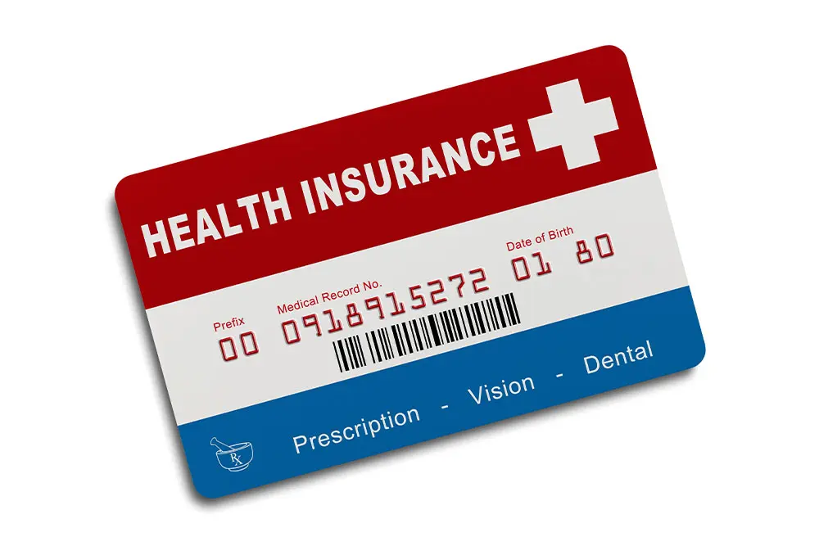
Problem: Unobtainable Medical Treatment due to Expenses
Millions of U.S. citizens face significant obstacles in terms of accessing essential medical treatment due to excessive costs, leading to untreated illnesses and diminished quality of life.

Slide 3
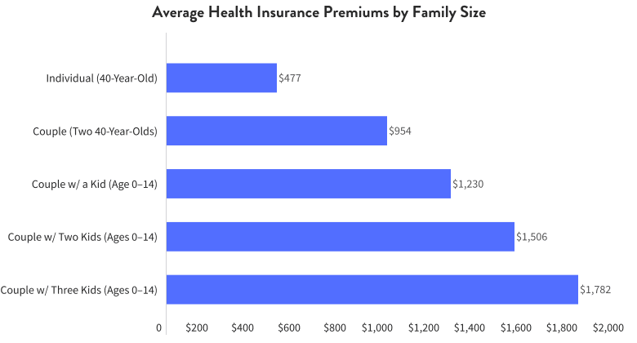

Slide 4
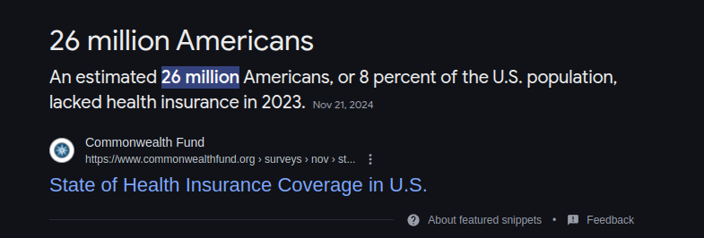

Slide 5

Solution: Drug Repurposing via Re:Medical
The purpose of Re:Medical is to develop a system utilizing AI technologies to identify drug repurposing potential within common household drugs to treat illnesses individuals may struggle to afford. This would be a step forward for bringing more affordable treatment options forward and enhancing efficiency in the market.

Slide 6
Future Scope:
Challenges Faced:
In the future, this technology can be expanded with more examples of illnesses and home remedies implemented. There is potential for an expansion in other categories like dietary or lifestyle changes, and upgrades to the user interface using separate frameworks.
A major problem we faced was representing our work in the most efficient and logical method possible. Creating proper reasoning utilizing complex queries and general error handling.

Slide 7
Contact
Peter Siba - pxs220108@utdallas.edu
Hadi Khan - hxk220085@utdallas.edu
Bruno Hernandez - bxh210016@utdallas.edu

